Slide 4
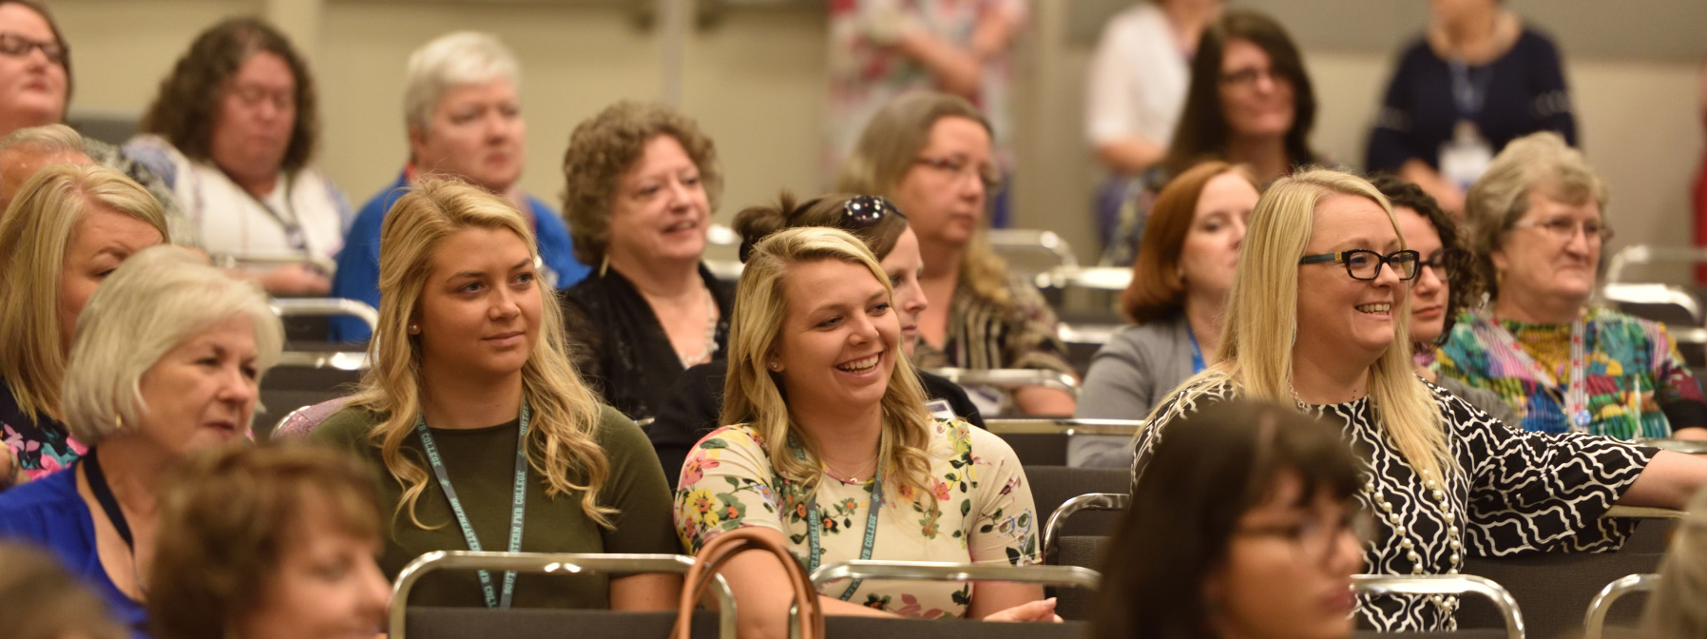
$425,000 missions and ministry causes

Slide 6
4 Categories of Giving To-date $2055
White — $10
Bronze — $25
Silver — $50
Gold — $100
Platinum — $101 and over

Slide 8
Facebook
Blog
Instagram

Slide 9
Social media for WNAC

Slide 12
$21,000 in cash, gift cards, and items

Slide 13
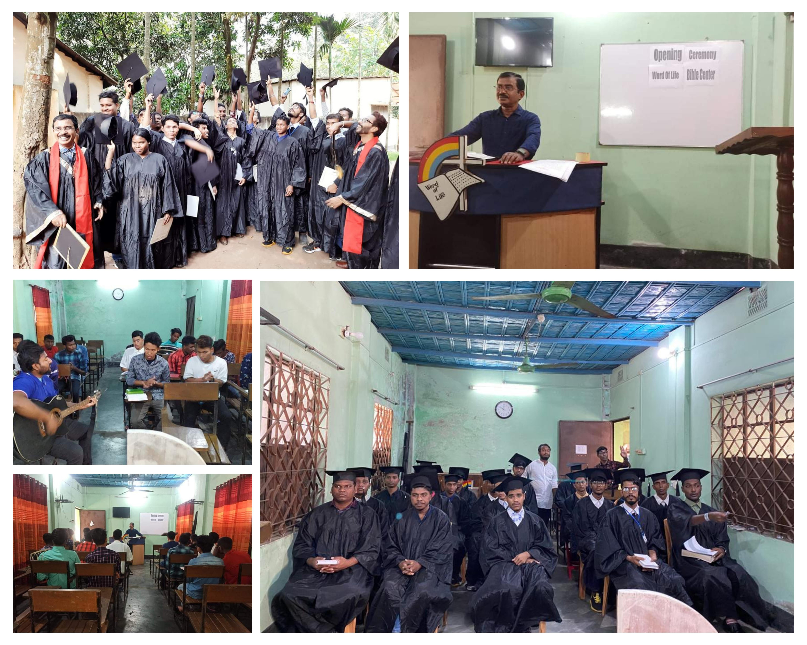
Cleo Pursell
Foreign Student
Scholarship Recipients
Word of Life School Of Evangelism
Bangledesh

Slide 14
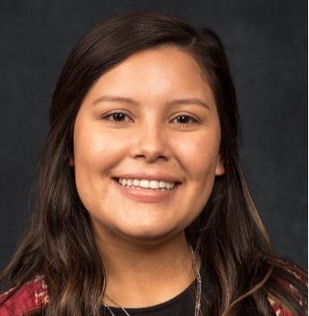
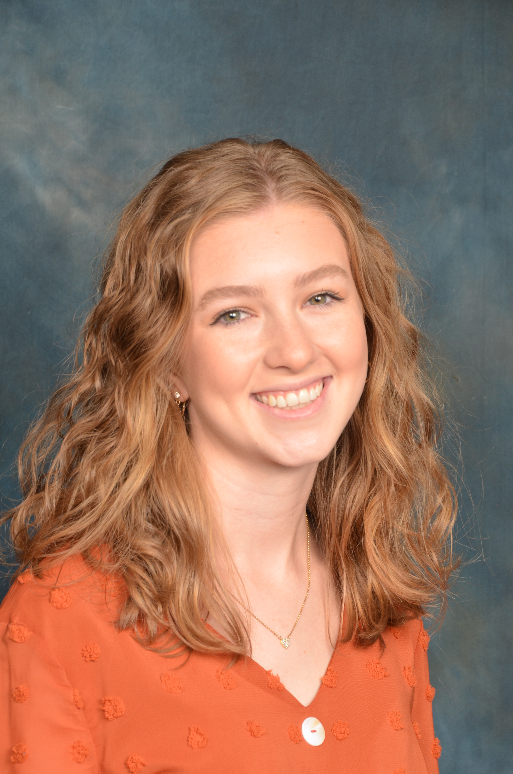
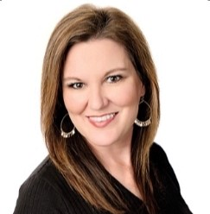
Dr. Mary R. Wisehart Scholarship Recipients
Leslie Arrendondo
Southeastern FWB
Heather Thomas
Welch College
Michelle Sharp
Randall University

Slide 15
Miley Recipient: Daniel Delgado

Slide 17
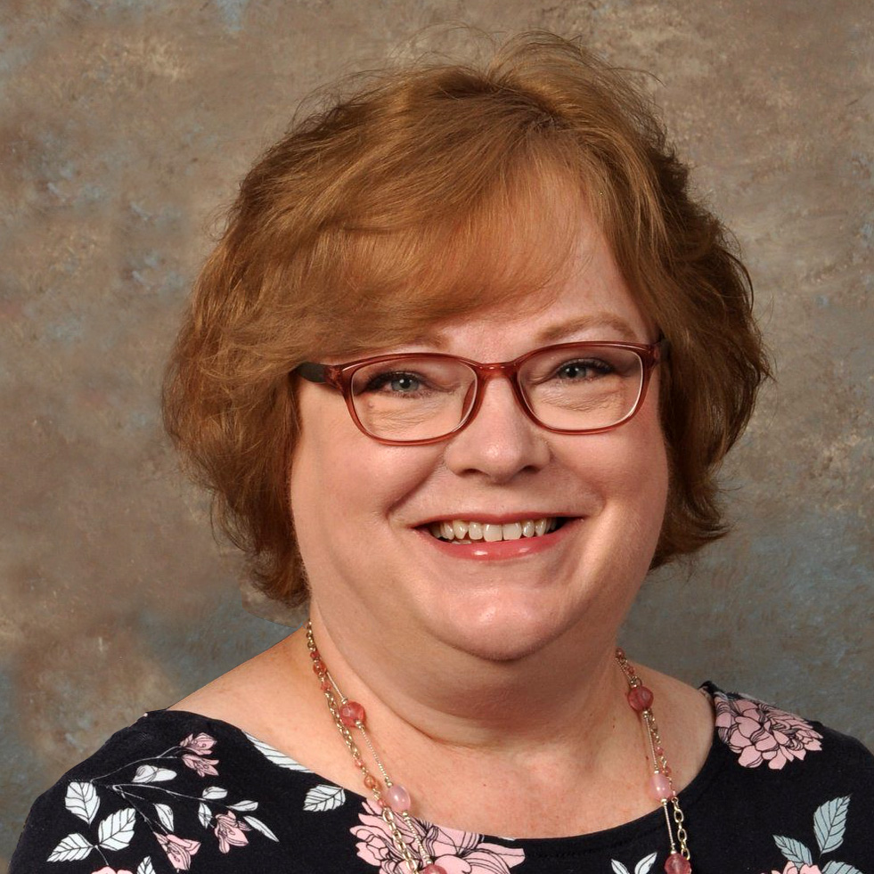
Ruth McDonald
New Director

Slide 18
Thank you for serving!

